Slide 1
A Seminar on Integrating Blockchain for Advanced Supply Chain Solutions
Team Details
Rathlavath Rajesh(20EG105401)
Gajjela Stevenson(20EG105412)
Neelagiri Chandradeep(20EG105429)
Project Supervisor
Dr. Pallam Ravi
Assistant Professor

Slide 2
Introduction
BLOCK CHAIN:
Blockchain is a type of Distributed Ledger Technology (DLT) where data is stored in blocks that are chained together. Each block contains a number of transactions, and once a block is completed, it becomes part of the timeline, or the "chain".
Each transaction on the blockchain is encrypted and linked to the previous transaction. This alongside the decentralization aspect, ensures a high level of security and transparency.
Supply Chain Management:
Supply chain management (SCM) is a comprehensive and strategic approach that encompasses the entire process of designing, planning, executing, controlling, and monitoring the supply chain activities. At its core, SCM involves the coordination and integration of various functions and processes, from the procurement of raw materials to the delivery of finished products to end customers. The primary objective of supply chain management is to optimize efficiency, minimize costs, and enhance overall performance throughout the supply chain network.
For effective supply chain management, several key elements are essential. First and foremost, a robust information system is needed to facilitate communication and collaboration among different entities within the supply chain. Real-time data sharing allows for quick decision-making, inventory management, and demand forecasting. Additionally, a well-defined and efficient logistics infrastructure, including transportation and warehousing, is crucial for the smooth flow of goods.

Slide 3
Applications:
Supply chain management finds applications across diverse industries, including manufacturing, retail, healthcare, and more. In manufacturing, SCM helps in streamlining production processes, managing inventory levels, and ensuring timely delivery of products. In the retail sector, SCM aids in inventory optimization, reducing stockouts, and improving customer satisfaction through timely order fulfillment. In healthcare, SCM is vital for managing the procurement and distribution of medical supplies and ensuring the availability of essential items in healthcare facilities.
Benefits:
Security
Transparency
Immutability
Accessibility
Reduced Costs and Increased Efficiency

Slide 4
Problem Statement
Lack of transparency and trust in traditional supply chain processes hampers efficiency
Current supply chain mechanisms face critical challenges such as limited transparency, ineffective information sharing, and suboptimal coordination among stakeholders. This project proposes a blockchain-based solution to revolutionize supply chain management. By leveraging blockchain's inherent qualities like immutable data records, enhanced security, and decentralized architecture, the proposed system aims to foster trust, improve transparency, and streamline information sharing across the supply chain network. This approach not only aims to optimize operational efficiency but also enhances the reliability and integrity of supply chain processes.

Slide 5
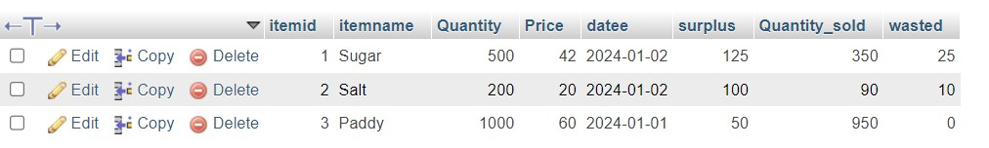
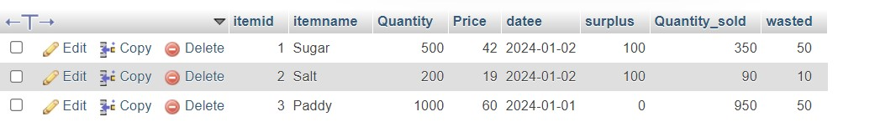
Problem Illustration
Before Tampering:
After Tampering:

Slide 6
Proposed Method
Proposed Method: blockchain-based supply chain system:-
Step-1: Research and Install Necessary Technologies
Step-2: Design the Network Architecture
Step-3: Create Smart Contracts
Step-4: Node Setup
Step-5: Testing
Step-6: Deploy the solution to the production environment
Step-7: Monitoring and maintenance

Slide 7
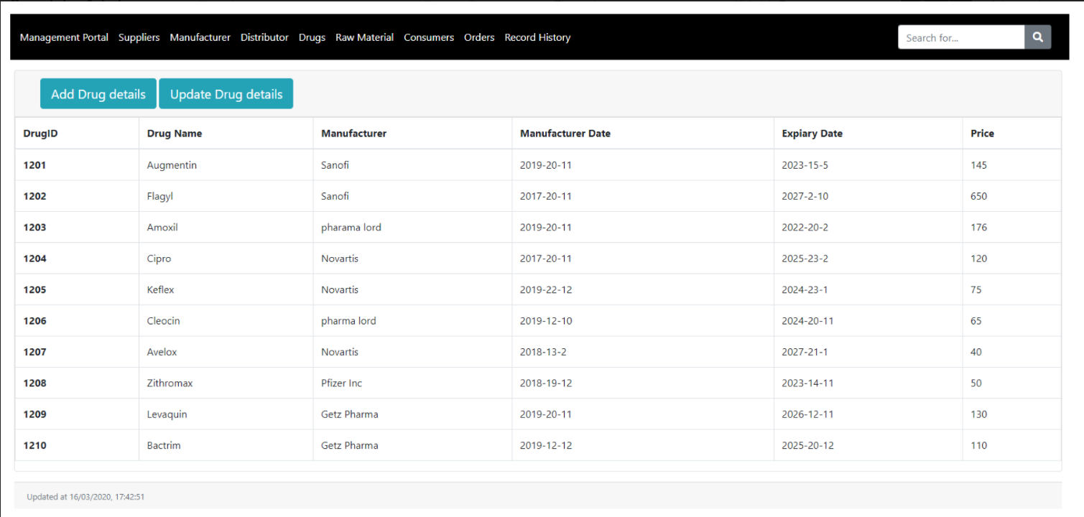
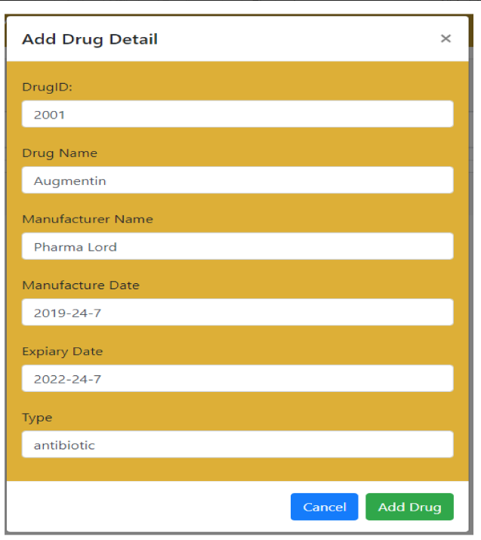
Proposed Method Illustration

Slide 8
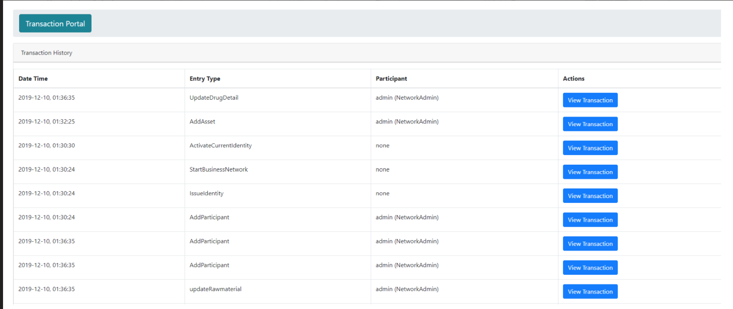
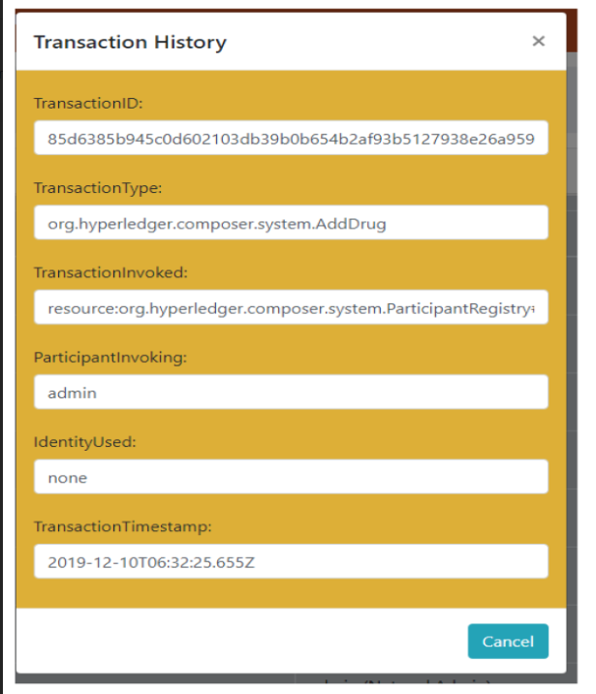
Proposed Method Illustration

Slide 9
Experiment Environment
Programing language used: Solidity since it is suitable for blockchain mechanism
Code editor used: Visual Studio code (Microsoft) as it is a light-weight code editor
Ganache :The functionality of Ganache as a high-end development tool, used for running your personal local blockchain network for developing decentralized applications on Ethereum as well as Corda.
Ethereum IDE : It’s a great innovation that makes a big difference to the capabilities of the tool. For developers remix offers a UI tailored around the needs of a blockchain developer with all the necessary tools and integrations needed in the workflow of creating smart contracts.

Slide 10
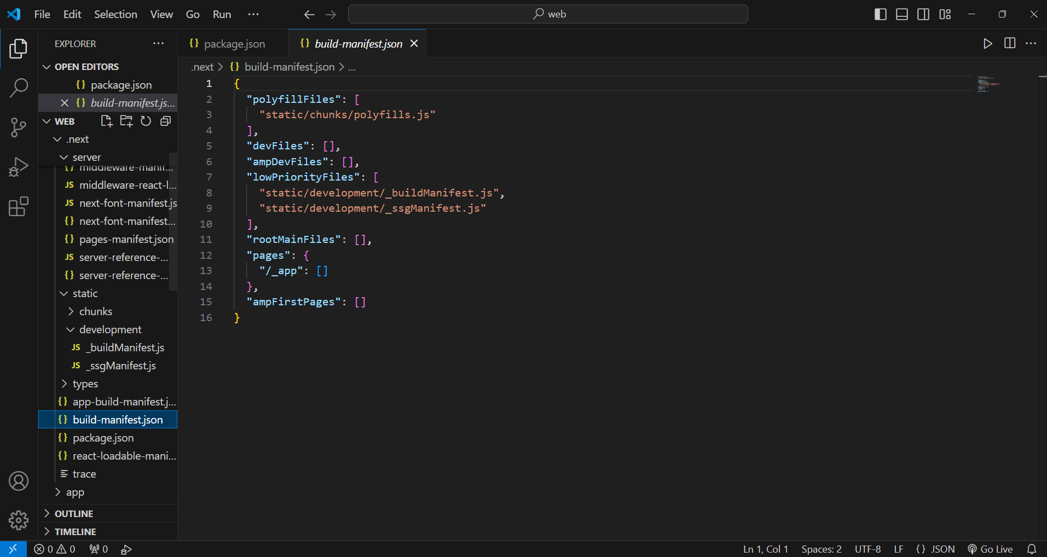
Experiment Screenshots

Slide 11
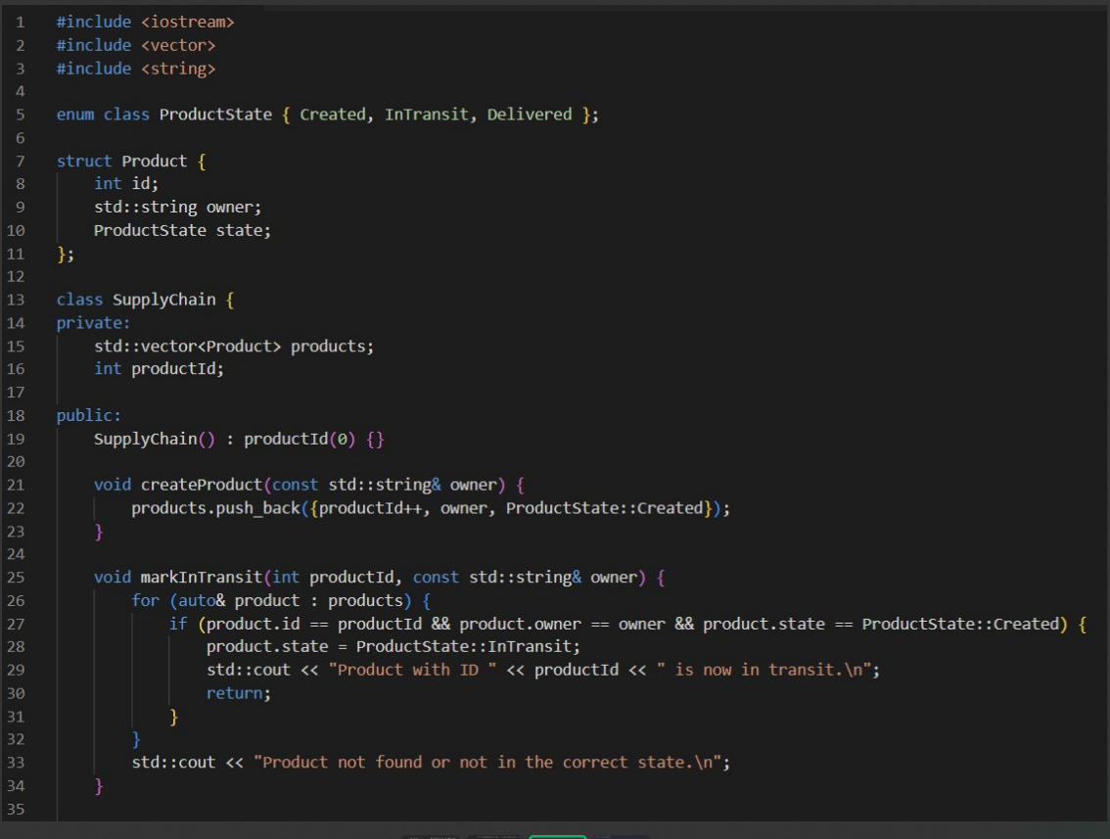
Experiment Screenshort

Slide 12
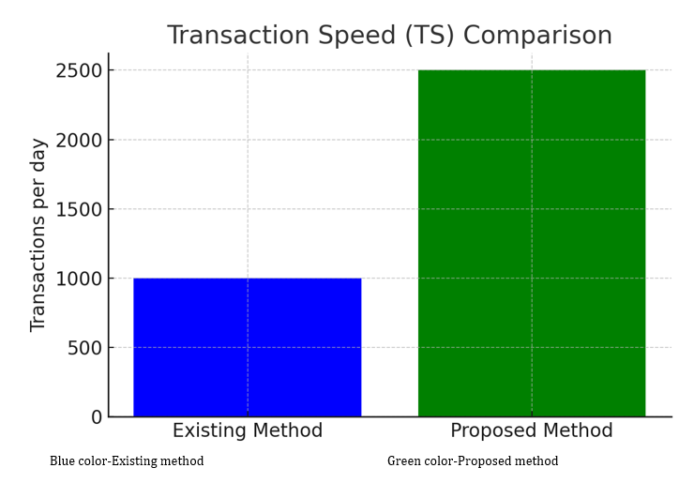
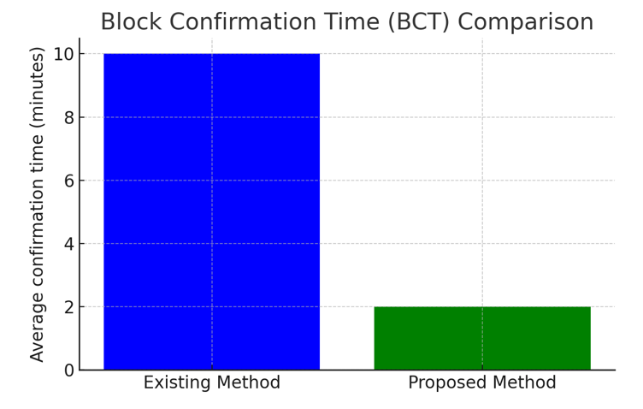
Experiment Results
1)Transaction Speed(TS)
2) Block Confirm Time(BCT)
Experiment | Existing Method | Proposed Method
Transaction Speed (TS) | 1000 | 2500
Experiment | Existing Method | Proposed Method
Block Confirmation Time (BCT) | 10 | 2

Slide 13
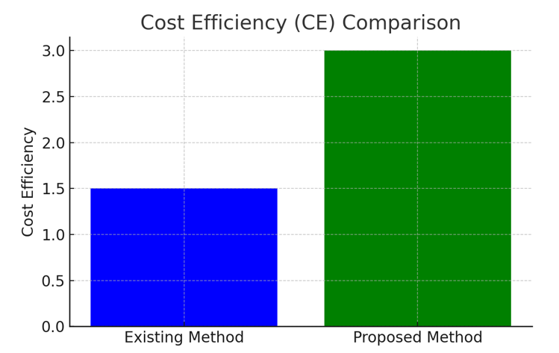
Experiment Results
3) Cost Efficiency(CE)
Experiment | Existing Method | Proposed Method
Cost Efficiency (CE) | 1.5 | 3

Slide 14
Finding
We evaluated three critical parameters (Transaction Speed (TS), Block Confirmation Time (BCT), and Cost Efficiency (CE)) together with Security Level (SL) in order to compare the efficacy of a suggested blockchain methodology with an established conventional method. Notable progress was made in each of these areas with the proposed blockchain technology. Specifically, it improved transaction throughput, decreased block confirmation times, and improved transaction security all at once. These findings suggest that the proposed blockchain solution can significantly enhance operational performance and economic sustainability, making it a particularly advantageous choice for modern digital transactions. The method's ability to handle higher transaction volumes more effectively and securely while producing better economic results highlights its potential for wider adoption across several sectors.

Slide 15
Parameters
1.) Transaction Throughput:
> TPS = Number of Transactions
Time taken
Latency :
> Formula: Latency= Time delay for a transaction confirmation
Scalability:
>Formula: Scalability =Number of Participants
Resources
4) Smart Contract Execution Time:
>Formula: Smart Contract Execution Time =Time taken for a smart contract to execute

